Slide 1
Shopping Mall Parking Smart Contract
Problem Statement
Need a smart contract to record and validate payments made by various customers for using the parking area in a shopping mall.
Assumptions
Every account would be the owner of a car. (account# -> car registration #).
Customer would check-in to parking area and check-out from the parking area.
Parking fees could be paid by the owner or his friends
Parking fees has slabs like (< 60 mins – 10 ethers, 60 -180 mins – 20 ethers, >180 - 30 ethers)
Offers/discounts on parking fees are available Offers like 50% discount if a shopping code and 10% for movie code
Outcomes
A Smart contract that allows
Add cars to various accounts (owner)
View cars and owner
Check-in to parking area (with movie ticket or without movie ticket)
Check-out from parking area by paying the parking fees from an account (owner or his friend)
Given the car number, display its parking history
Given an account number, display the payment history

Slide 2

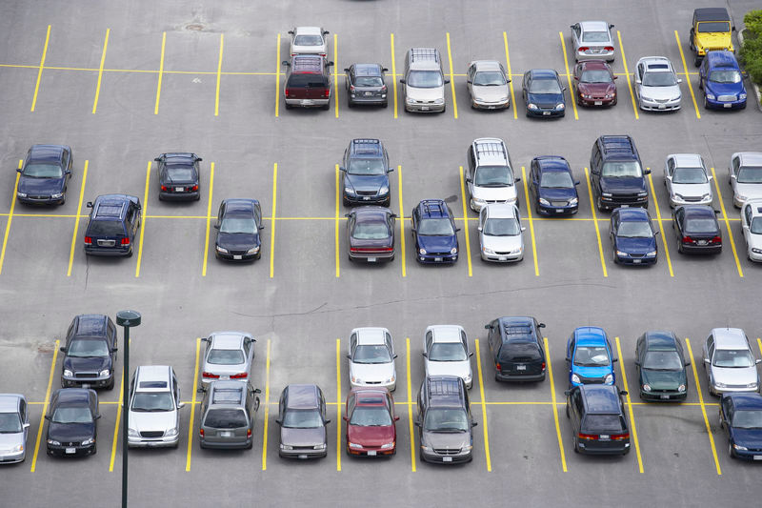
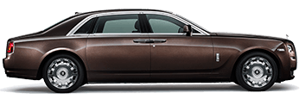
PARKING LOT
CHECK-IN
CHECK-OUT

Slide 3
Mobile Talk-time Barter Smart Contract
Problem Statement
Need a smart contract to record and validate transfers of talk time to friends when requested i.e., mobile talk time can be bartered (or transferred) .
Assumptions
Every account would be the owner of a mobile phone.(account# -> mobile phone #).
Mobile Phone Owner would spend some ether for talking.
If the talking time, reaches minimum balance, then a phone owner can send a request to all his friends to add talk-time to his account.
Friends can choose to transfer some ether to other friends by maintaining their minimum balance.
Every transfer of talk-time (ether) would be charged by the Mobile Company.
Outcomes
A Smart contract that allows
Add mobile to various accounts (owner)
View mobile phones and owners
Talk to spend ether from the account. Charge 1 ether per minute
Request other owners for talk time.
Transfer talk-time to other owners
Given the Mobile number, display its transfer history

Slide 4





Request TalkTime
Transfer TalkTime
Transfer TalkTime

Slide 5
Gold Vault Smart Contract
Problem Statement
Need a smart contract to report amount of gold stored and its purity to the owners and generate weekly rental invoices.
Assumptions
Two accounts shall be used as Gold Owners
Three accounts shall be used as Gold Vault Owners
Three accounts shall be used as Gold Vaults
Gold Owners can deposit his gold in multiple Gold Vaults.
Weekly Rental charges of Gold Vaults can vary.
Gold Owners must be reported appropriately if gold can be stored in the Gold Vault or not.
Gold Owners would pay rental to Gold Vault Owners.
Outcomes
A Smart contract that allows
Add gold to Gold Vaults
View Gold Vaults and owners
View Gold Vaults, Gold Vault Owners and Gold Owners
Report Rental charges to Gold Owners
Transfer Rental Charges to Gold Vault Owners
Given the Gold Owner, display rental payment history
Given the Gold Vault Owner, display rental receipts history

Slide 6

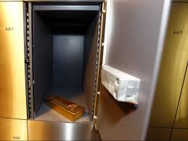

Gold Owner
Gold Owner
Deposit Gold
Gold Vault
Pay Rent
Gold Vault
Gold Vault
Gold Vault Owner
Gold Vault Owner
Gold Vault Owner

Slide 7
Supply Chain Smart Contract
Problem Statement
Need a smart contract to record temperatures of cold storage vehicles at specified transit points, and generate payment advise.
Assumptions
Two accounts shall be used as Supplier
Two accounts shall be used as Cold Storage Vehicle.
Three accounts shall be used as Transit Thermometers
Two accounts shall be used as Retailer.
One account shall be used as Distributor
At start of supply, supplier shall record and broadcast the current temperature of the cold storage.
On arrival at a transit point, Transit Thermometers shall record and broadcast temperature of cold storage vehicle to Retailer, Supplier and Distributor.
On arrival at the destination, the buyer shall record and broadcast the current temperature of the cold storage, and generate the advise of payment.
If the temperate drops at transit points or destination, the supplier is penalized by the Distributor. Refer UI for information.
Outcomes
A Smart contract that allows
View Consignments
Record and Report current temperature of Cold Storages at all points (source, transit and destination)
Generate payment advise for supplier
Payment to Distributor by Retailer
Payment to Supplier by Retailer
Given the Cold Storage vehicle, payment history
Given supplier, display receipts history

Slide 8
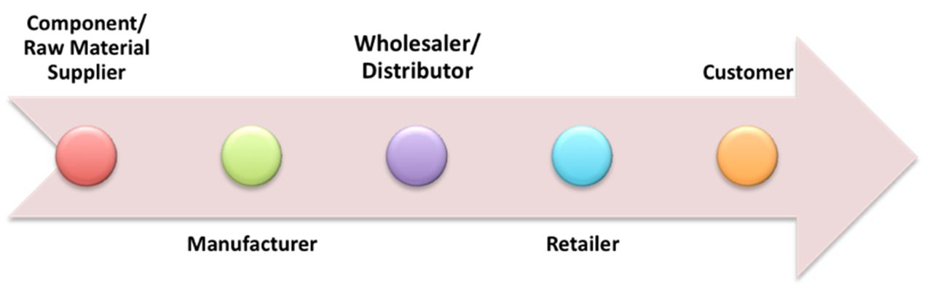

Supplier
Transit-1
Transit-2
Transit-3
Distributor

